Slide 1
Nuclear Fuel Performance
NE-591-010
Spring 2021

Slide 2
Feedback Summary
Thanks for everyone providing feedback
Reasonable difficulty; Decent pace; Good relevance
Provide more example problems throughout lectures, practice exams, etc.
Include additional info on slides
Adding homework
Additional reading materials
More time on exam

Slide 3
Paper assignment
I have assigned each of you a paper to read and review
We will have 12 minute presentations from each person on March 9 and March 11 summarizing and analyzing their respective paper
Papers available on Moodle
I will randomly select students to go on each day, and you will be notified the week before
Everyone will upload their slides into Moodle by 11:59 pm March 8
it will lock at midnight

Slide 4
Last Time
Solid mechanics predicts the deformation of a body from its applied load
The strain defines the deformation
The stress defines the material’s internal response to the strain
Materials can have recoverable and permanent deformation
Elastic deformation is recoverable and occurs due to the stretching of the atomic lattice
Plastic deformation is permanent and results form the breaking of bonds during dislocation (line defect) migration
We derived two analytical solutions for the stress in a pressurized cylinder
Thin walled cylinder
Any size wall

Slide 5
THERMO-Mechanics

Slide 6
Thermal Expansion
As the temperature increases, atoms have larger vibrations, causing the material to expand
This expansion doesn’t raise the energy of the material when unrestrained
This expansion can be treated as a strain, but as one that doesn’t cause stress

Slide 7
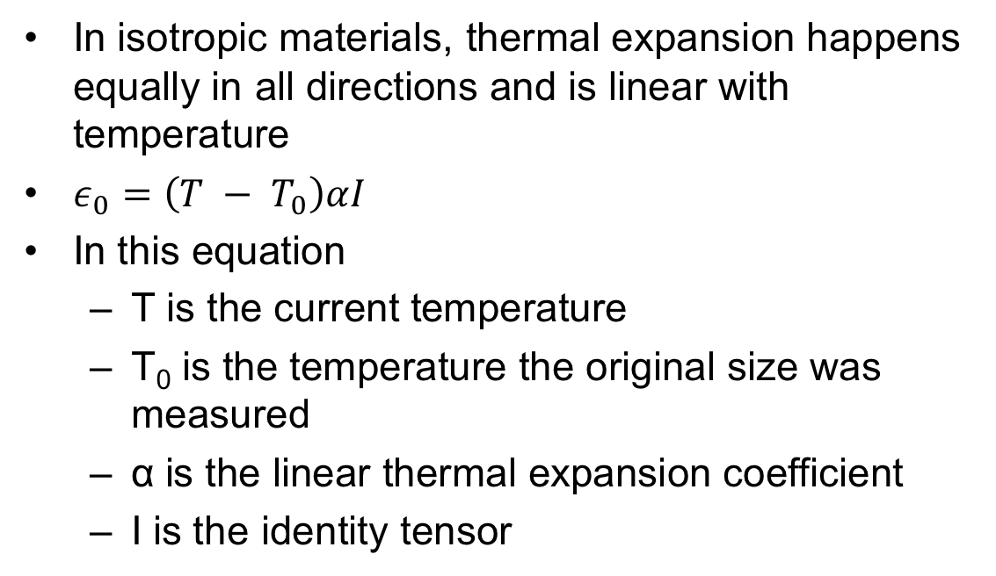
Thermal Expansion
In isotropic materials, thermal expansion happens equally in all directions and is linear with temperature
$ε_{0}=\left(T − T_{0}\right)αI$
In this equation
T is the current temperature
T₀ is the temperature the original size was measured
α is the linear thermal expansion coefficient
I is the identity tensor

Slide 8
Thermal Expansion
Though thermal expansion doesn’t directly cause stress, it can still lead to thermal stress

Slide 9
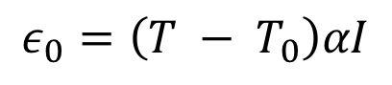
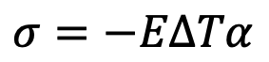
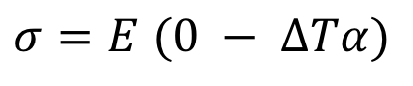
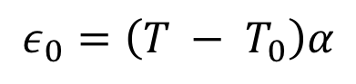
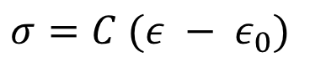
What is the stress in a thin constrained rod of length L when it is heated to ΔT?
The rod has a Young’s modulus of E and an expansion coefficient of α
$$ε_{0}=\left(T − T_{0}\right)αI$$
$σ=C (ε − ε_{0})$
$$ε_{0}=\left(T − T_{0}\right)α$$
$σ=E (0 − ΔTα)$
$σ=−EΔTα$

Slide 10
The large temperature gradient within a fuel pellet results in large thermal stresses

Slide 11
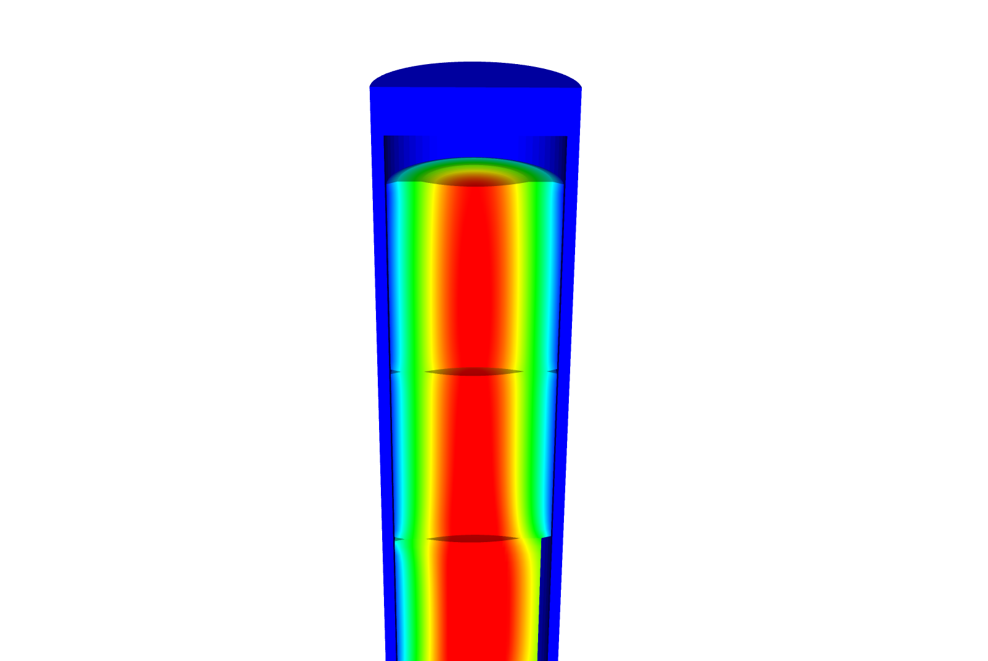
Consider the material response of the axisymmetric body
We assume small strains, so the strain is defined as
We assume isotropic material response, so

Slide 12
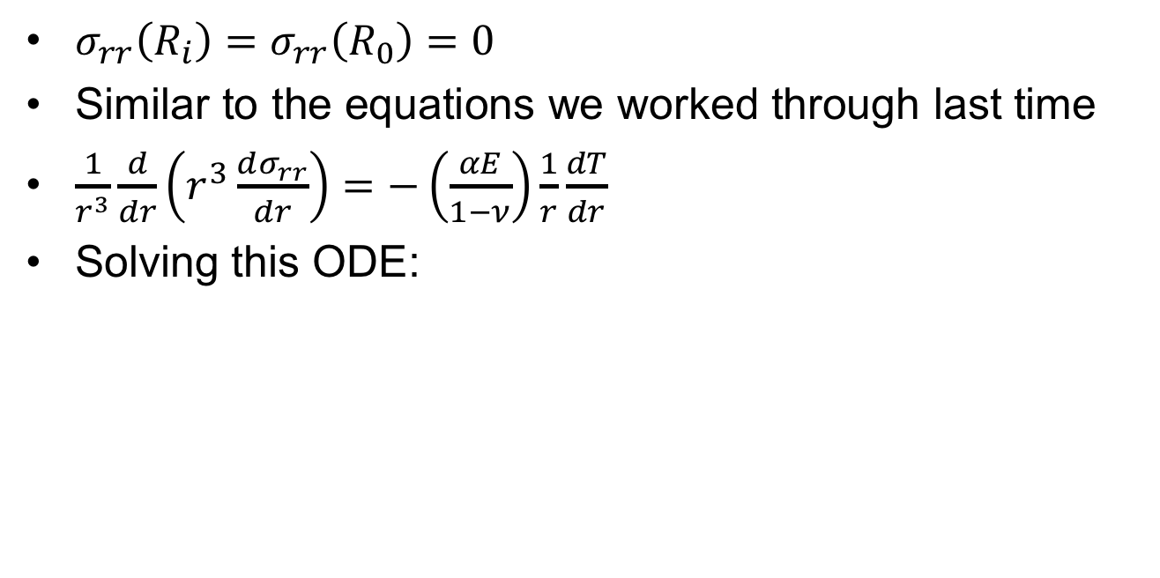
Consider a cylinder with thermal expansion but not pressure
$σ_{rr}\left(R_{i}\right)=σ_{rr}\left(R_{0}\right)=0$
Similar to the equations we worked through last time
$\frac{1}{r^{3}}\frac{d}{dr}\left(r^{3}\frac{dσ_{rr}}{dr}\right)=−\left(\frac{αE}{1−ν}\right)\frac{1}{r}\frac{dT}{dr}$
Solving this ODE:

Slide 13
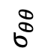
What is the hoop stress in the cladding?
$$σ_{θθ}$$
r
R_{i}
R_{f}

Slide 14
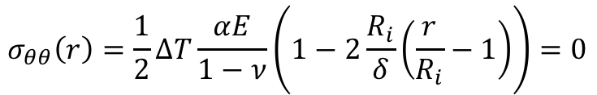
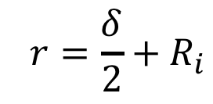
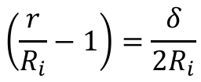
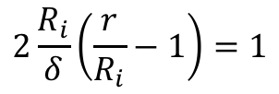
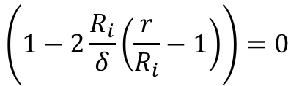
Where is hoop stress equal to zero?
$$σ_{θθ}\left(r\right)=\frac{1}{2}ΔT\frac{αE}{1−ν}\left(1−2\frac{R_{i}}{δ}\left(\frac{r}{R_{i}}−1\right)\right)=0$$
$$\left(1−2\frac{R_{i}}{δ}\left(\frac{r}{R_{i}}−1\right)\right)=0$$
$$\left.2\frac{R_{i}}{δ}\left(\frac{r}{R_{i}}−1\right)\right.=1$$
$$\left.\left(\frac{r}{R_{i}}−1\right)\right.=\frac{δ}{{2R}_{i}}$$
$$\left. r\right.=\frac{δ}{2}+R_{i}$$

Slide 15
The linear temperature gradient across the cladding causes axial thermal stresses

Slide 16
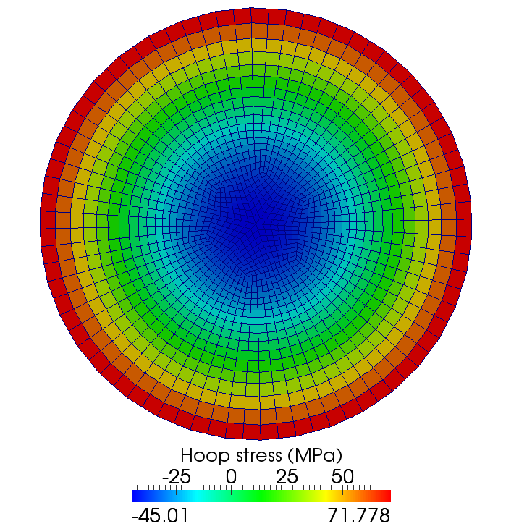
Same approach to the thermal stress in a fuel pellet
The thermal stress is due to the temperature gradient

Slide 17
Solve this stress ODE
The boundary conditions are:
Once we solve it, we obtain
Then we can solve the hoop stress
The axial stress is more complicated to obtain, but you end up with

Slide 18
The fuel temperature gradient causes large thermal stresses

Slide 19
How far do fuel cracks extend?
E = 200 GPa, ν = 0.345, α = 11.0e-6 1/K, σ_{fr} = 130 MPa, ΔT = 550 K
Solve for η
– σ_{fr} / σ* = 1 – 3 η²
3 η² = 1 + σ_{fr} / σ*
η = ( (1 + σ_{fr} / σ*)/3 )^{½}
σ* = 11.0e-6*200*550/(4*(1 – 0.345) ) = 461.8 MPa
η = sqrt( (1 + 130/461.8)/3 ) = 0.65

Slide 20
The gap changes as a function of time
Both the pellet and the cladding swell
But, as the gap decreases, the temperature changes, which again makes the gap change
The solution using the analytical equations is iterative, due to the dependence of the gap size and temperature.

Slide 21
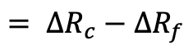
Calculate the steady state temperature profile in the rod, including thermal expansion
LHR = 200 W/cm, δ⁰_{gap} = 30 μm, R_{f} = 0.5, T_{cool} = 580 K, T_{EXP,0} = 373 K, k_{gap} = 0.0026 W/cm-K, t_{C}= 0.06 cm, α_{f} = 11.0e-6 1/K, α_{C} = 7.1e-6 1/K
ΔT_{cool} = 25.5 K, ΔT_{clad} = 22.5 K, ΔT_{fuel} = 530.5 K
So, T_{IC} = 580 + 25.5 + 22.5 = 628.0 K, T_{s} = 701.5 K, T₀ = 1232.0 K
First, we will deal with expansion in the cladding
Av(R_{c}) = 0.5 + 30e-4 + 0.06/2 = 0.533 cm
Av(T_{C}) = 580 + 25.5 + 22.5/2 = 616.75 K
ΔR_{c} = 0.533*7.1e-6*(616.75 – 373) = 9.22e-4 cm
$$= ΔR_{c}−ΔR_{f}$$

Slide 22
Calculate the steady state temperature profile in the rod, including thermal expansion
Second, we deal with the fuel
Av(Tf) = (1232 + 701.5)/2 = 966.7 K
ΔR_{f} = 0.5*11e-6*(966.7 – 373) = 0.0033 cm
The total change in the gap is 9.22e-4 – 0.0033 = -0.0023
However, that means the gap is smaller and so our temperatures were wrong!

Slide 23
This calculation is repeated until the gap width stops changing significantly
The change in the gap does NOT effect the coolant or cladding temperatures, just the gap and fuel temperatures.
We only need to repeat the calculation of the fuel and cladding temperatures and the change in the gap
Iteration | δ_{gap} (cm) | T_{s} (K) | T₀ (K)
0 | 0.003 | 701 | 1232
1 | 0.00066 | 644 | 1174
2 | 0.00097 | 652 | 1182
3 | 0.00094 | 651 | 1181
4 | 0.00094 | 651 | 1181

Slide 24
Analytical Thermomechanics Summary
Increases in temperature cause most materials to expand
We call this thermal expansion, which is a strain that doesn’t inherently cause stress
Thermal expansion can cause stress when
Deformation is constrained
There are gradients in the expansion coefficient
There is a temperature gradient
We have analytical equations for thermal stresses in the cladding and in the fuel

